Slide 1
ETC3250: Spam Project
Harry Austin, Ben Craine, Kamalpreet Singh, Tim Wilson

Slide 2
Introduction
We are ReSpampling.
Aim of project was to accurately classify emails as spam or not spam.
Import, clean, transform, visualise, model.
Choose the model which does a good job at classifying spam.

Slide 3
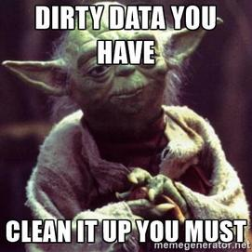
The Data

Slide 4
The Data
Slightly fewer than 3000 observations.
22 observations with missing values, all from Domain variable.
To keep or not to keep, that is the question.
Delete
Impute
Treat missing values as a value
Why treat missing values as a unique value?

Slide 5
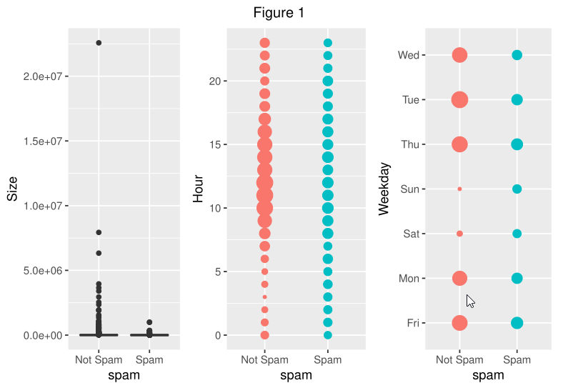
The Data

Slide 6
Methods
Method | Accuracy
KNN | 0.7232
Logistic Regression | 0.8303
LDA | 0.7889
Ridge Regression | 0.6859
Lasso Regression | 0.8282
SVM | 0.7455
Regression Tree | 0.8404
Bagging | 0.8616
Random Forest | 0.8737

Slide 7
Random Forest
Collection of classification trees
Variance Bias Tradeoff
The premise of Random Forest is to collate many classification trees
Advantages? Disadvantages?
Variance Bias Tradeoff
Interpretability
Notes:
Point 1: Each classification tree has low bias but high variance =>

Slide 8
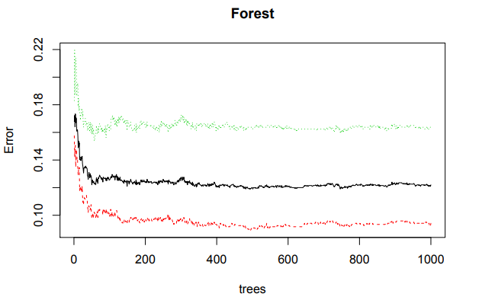
The Model
Random Forest
Data
Mtry = 13
Ntrees = 1000
importance

Slide 9
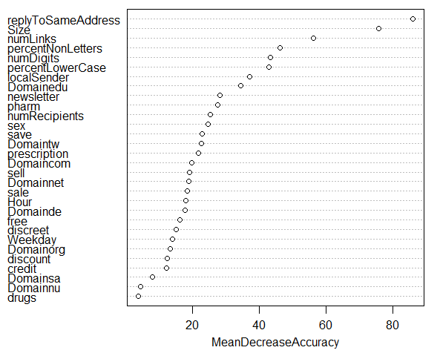

Slide 10
Problems Encountered
Dummy variables had to be created for categorical variables (domain and days of week)
Missing values for domain replaced with real value
The training and test sets don’t have exactly the same domains, which meant that the dummy variables did not match. Extra categorical variables are added to each dataset to resolve this.

Slide 11
Conclusion

